Slide 1
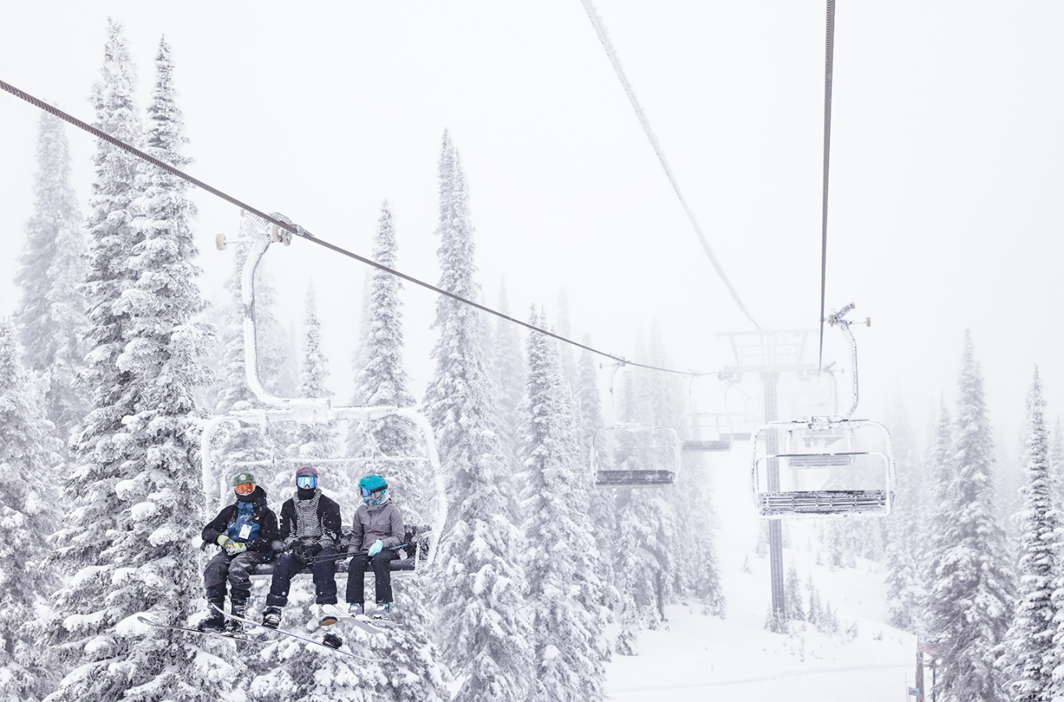
The Big Mountain Resort Pricing Strategy
Sorce: https://flatheadbeacon.com/2021/12/10/skiers-all-smiles-on-opening-day-at-whitefish-mountain-resort/

Slide 2
Problem Identification
What opportunities exist for the Big Mountain Resort to get better value for their ticket price by the next skiing season through assessing impact of resort facilities on ticket price?
Current prices at the resort are based on market average. However ticket prices can assumingly be higher if resort facilities are better capitalized. According to this, management needs to set a better price based on the affect of infrastructure importance for clients on the ticket price rather than just market average.

Slide 3
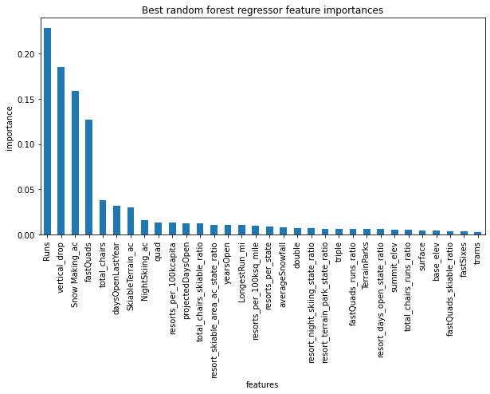
Modeling results and analysis
Out of all available features, 4 showed the strongest correlation with the price:
Runs – number of runs on the resort.
Vertical drop – vertical change in elevation from the summit to the base.
Snow Making_ac – total area covered by snow making machines.
FastQuads – the number of fast four person chairs.
A machine learning model based on available features was created to predict optimal ticket price as well as possible price increase based on changes of resort’s infrastructure.

Slide 4
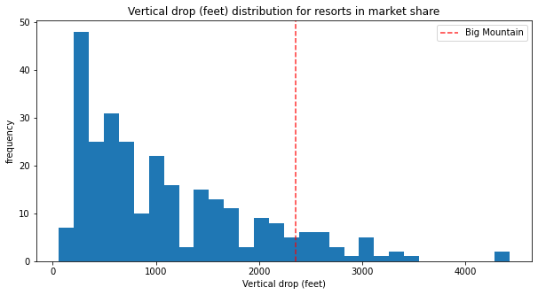
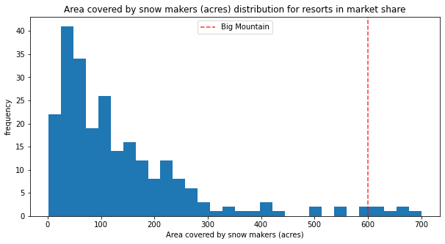
Modeling results and analysis
Big Mountain has one of the longest vertical drops compared to other resorts.
Big Mountain has one of the largest snow covered areas.

Slide 5
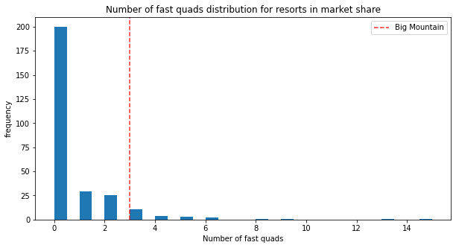
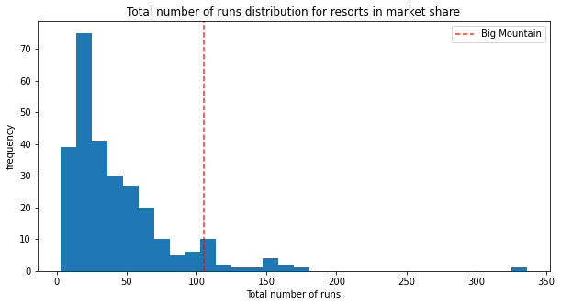
Modeling results and analysis
Big Mountain has amongst the highest numbers of fast chairs.
Big Mountain has one of highest total number of runs.

Slide 6
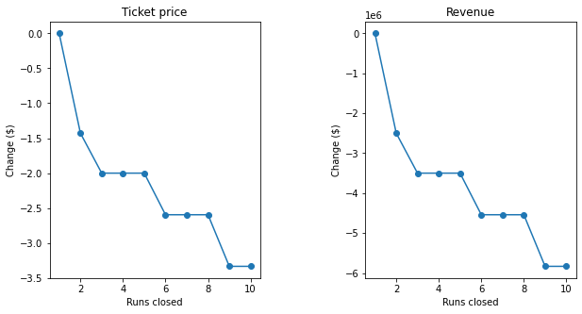
Summary and recommendations
Created model suggested ticket price of $97.79 which is much higher than current $81, therefore there is definitely a room for price increase.
Model also suggested that closing 1 run won't have any effect on the price. Closing 2-3 runs will successively reduce the price by total of $2 with total revenue loss of $3500000. However closing 4-5 runs doesn't cause further price drop.

Slide 7
Summary and recommendations
Modelled increase of vertical drop, addition of a 150 feet run and installation of an additional chair lift suggested ticket price increase by $9.60. Over the season, this could increase total revenue by $16791667 taking into consideration a number of visitors per season.
Adding 2 acres of snow cover to the parameters above suggested support for ticket price increase by $13.86. Over the season, this could increase total revenue by $24250000.
Even though scenarios tested above suggested price increase, data on operating costs are necessary to establish whether operating costs of newly added features will not exceed predicted revenue increase.

